Slide 1



Multiple fault localization using constraint programming and pattern mining
N. Aribi . M. Maamar . N. Lazaar . Y. Lebbah . S. Loudni
ICTAI’17
Boston, USA, 11-07-2017

Slide 2
Software Testing
Process of evaluating a system to check if it respects its specifications (Oracle)
Three main purposes:
Detection
Localization
Correction
Notes:
- So to start, Software testing is the Process of evaluating a system or a program with the aim to check if the program respects its specifications.
- Essentially there is 3 steps : detect the presence of faults in the program, localize the origin of faults, our work is focused on this second step, and finally the correction of the founded faults

Slide 3
Faults localization
The need: identify a subset of statements susceptible to explain the origin of the errors.
Accurate localization ↔ size of the subset
Spectrum-based approaches: (metrics – suspicious score)
Tarantula [Jones et al, 2005]
Ochiai [Abreu et al, 2007]
Jaccard [Abreu et al, 2007]
…
Notes:
So in faults localization The need is to identify a subset of statements that are susceptible to explain the origin of the errors.
The presion is evaluated wth the size of the returned subset, smaller is this subset, more efficient is the used method, it means that the programmer need to analyse not many statement before catching the one containing the fault
Several approaches have been proposed for this issue, approaches using trace exection like NN, approache based on suspiciousness measures, like tarantula (these approaches are the most known) and qpproaches using data mining, the most recent one is F-Cpminer that us declarative itemset mining

Slide 4
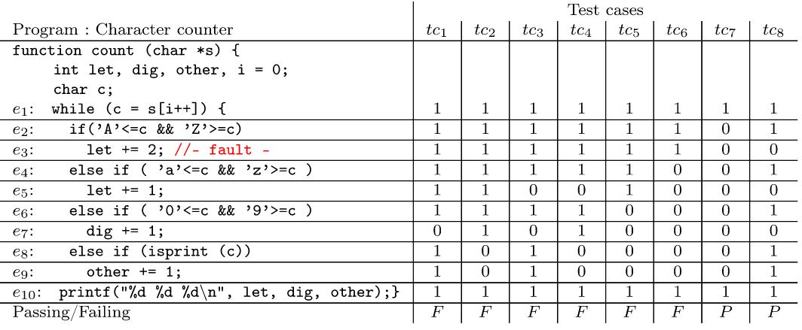
Multiple Faults Localization (MFL) : Context
Test case: tc_{i} = (D_{i} , O_{i})
Test suite: T = {tc₁ … tc₈}
Test case coverage: statements executed at least once
7
//-fault-
: Passing/Failing
Suspicious code ?
Aim : Ordering
Notes:
Here is an example of a program under test, so wa have a rogram with 10 statements where the third is faulty, we run the program with a test case, which is a pair of an input and an expected output, the test case can be either positive or negative depending on the returned output, we have the test suite to test the program under differents conditions.
During the execution of the program under a certain test case, one of the collected informarions are the instructions executed at least once which is called test case coverage, here 0 means that is not executed otherwise it is 1
When some test cases fail, a part of the code are suspected, they are the one executed often on negative test case and rarely on potive one. To localize the faulty staments the code is then ordered from the most suspicious statements to less suspicious.

Slide 5
Spectrum-based approaches
Differents ways to evaluate!!
Advantage:
Quick evaluation of each statement
Drawbacks:
Evaluating statements individually and independently of each other
Single Fault at time
Notes:
We show here how measure suspicious evaluate the suspicousness of each statements, we highlight that there are difference between the measures depending on the probabilstic formula that use the approach and some oh them allow some tolerance to a statement to be executed by positive test cases
Advantage and drawbacks

Slide 6
Research Questions
1- How to exploit dependencies between executions for MFL ?
2- How data mining can assist Multiple MFL ?
Itemset Mining
CP
Constraint Programming
Multiple Fault Localization
FOR
User-constraints
Notes:
The question is to say there dependencies between statements execution, and we try to catch these dependencies to improve the localization. Here the data mining can be interssting to use for this task but how?
Our idea is to instead of consider each statements individualy we try to
Extract a set of suspicious itemsets (set of statements)
We use a declarative approach based on a Constraint Programming, the aim is to have
A generic tool catching easly various user constraints

Slide 7
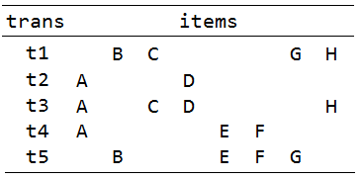
Itemset Mining (IM)
Set of items: I = {A,B,C,D,E,F,G,H}
Set of transaction: T = {t1,t2,t3,t4,t5}
Itemset: P ⊆ I
Cover(AD)= {t2,t3}
frequency = The size of cover
freq(AD) = 2
Notes:
I just want to show .. What is the propose of itemset mining, we have a dataset where we have set of items and set of transations where each transaction … a set of items, an itemset is a subset of item, a cover of an itemset is the set of transaction where it appears, for example here the cover of AD is t2 and t3
The frequency

Slide 8
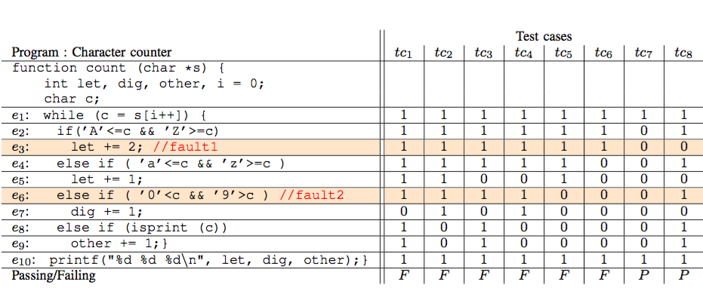
MFL problem as IM task
Test suite coverage = transactional database
- each statement e_{i} corresponds to an item
- each test case coverage tc_{i} forms a transaction
Notes:
The fact is that the test suote coverage can be seen as transactionnel itemset where each statement e_{i} corresponds to an item
- each test case coverage tc_{i} forms a transaction

Slide 9
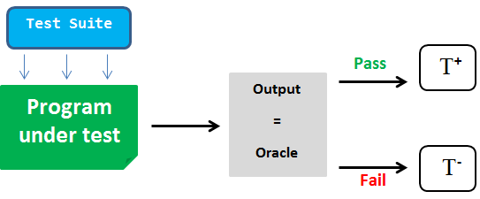
MFL problem as IM task
The transactional database is partionned into 2 disjoints classes:
The aim: Extract relevant itemset (top-k suspicious patterns)
Notes:
As there are 2 kinf of test cases positive and negative the dataset here is partionned in two classes positive dataset and negative one, the aim here is to exctract relevant itemset, those that reveal the contrast between the two dataset we call the here top-k suspicious patterns

Slide 10
MULTILOC approach
Negative
Positive
Extract top-k suspicious patterns: Declarative way
Statement ranking: produce a more accurate ranking
Using the global constraint ClosedPattern [Lazaar et al, 16]
Notes:
Our appraoch is called MultiLoc, to mine topk suspicious pattern our inputs are positiv and negative dataset, for the declarative approach our approach is based on an efficient global constraint named ClosedPattern desgined to extract closed patters which are a particular class of pattern
There is a second step on our approach where we try to refine the extract pattenr since these ones can be quite large, the aim is hav a more accurate ranking

Slide 11
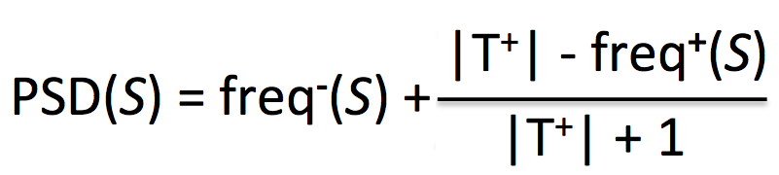
top-k suspicious itemsets
Pattern Suspiciousness Degree:
PSD(S) = freq⁻(S) + |T⁺| - freq⁺(S)
|T⁺| + 1
Dominance relation:
S ≻_{R} S’ iff PSD(S) > PSD(S’)
produce
top-k suspicious itemsets
Notes:
To extact the topk suspicious itemset, in our model we have define a measure to evaluate the suspiciousness of each extracted pattern, the PSD measure is based on the pattern’s frequency in negative and positive dataset and the size of the dataset, more the pattern will be frequent in the negative dataset, more higher will be the PSD.
We have defined a dominace relation between pattern based on PSD, a pattern S is prefered to S’ is its PSD is higher, the aim is to prouce the top-k pattens where any pattern is not dominated

Slide 12
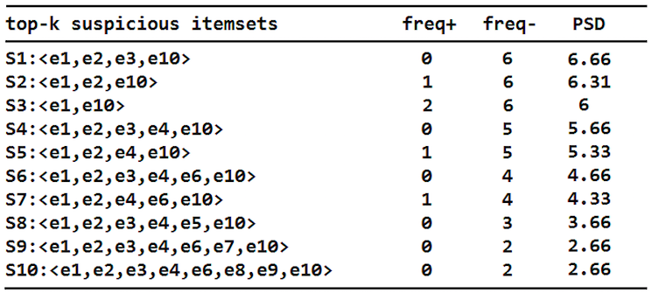
top-k suspicious itemsets : Example
most
suspicious
less
suspicious
Notes:
Here we show with the previous example, the topk pattern that are extracted wuith their PSD value, the patterns are ranked from the most supicious (with the highest PSD) to the less suspicious (with smallest PSD)

Slide 13
top-k suspicious itemsets : Analysis
- Each itemset : subset of statements that can locate faults
- 1st localization: itemsets can be quite large
Pattern S_{i}
Pattern S_{i+1}
some statements appear/disappear
2 categories of statements composing top-k
Notes:
After the first based that extract the topk suspicious pattern, w perform an analyse on these patterns. Here each pattern is a subset of statements that can contains the faults of the program. These are considered as a first localization, but here the patterns can be large, so we conduct a post-treatemnt to understand better the information provided by these patterns.
We have seen that From a pattern to the next one which is less suspicious some statements appear/disappear according to their frequencies in both dataset. We have established some rules and observations and we have extracted 3 categories of statements that compose the top-k suspicious itemsets

Slide 14
top-k suspicious itemsets : Ranking
Observations and rules:
Statements∈ S_{i} and disappear in S_{i+1}
Suspect : most suspicious
Statements that belong to all S_{i}
Guiltless: Neutral
Ordering List = < Suspect statements, Guiltless statements >
Notes:
The first group of statements are the most suspicous, these statements aprear in a certain pattern and are not in the next one which is less supicious which suggests that these statements are the reason of the high suspicious of the first pattern, so this make these statement high suspicious
The second group are statements that appear gradually on the patterns when the PSD decreases, these statements are suspicious for a certain degree depending on the pattern where they appear
The last group are statements that are present in all patterns whatever their PSD, this suggests that these statements are for example declaration statements and they are considered as Guiltless
So finally, or ranking list is composed with suspect statements first, pending and guiltless.

Slide 15
Experiments : Benchmark
Single Fault benchs: Siemens Suite (111 programs)
Multiple Fault benchs: 15 versions with 2 ,3 and 4 faults
MULTILOC : tool in C++ implementation
CP model using Gecode Solver
Efficiency measure : ExamScore (% of code to examine)
P-Exam, O-Exam
Notes:
For the experimental result we have tested the approach using programs with signle faults, for that we have used the simenens suite, containg more than one hundred programs and programs containing multiple faults, for that we have combined single version ramdomly to create programs with 2, 3 and 4 faults
Ou tool named MultiLoc is written in C++. The CP model uses Gecode solver
To measure the effeincy of approchaes in localization we used the ExamScore measure, that return the percentage of statements to examine before catching all faults in the program. There is 2 variant of this measure, pessimistic and optimistic one, when we have a group of statements with the same suspiciousness it depend if we take the faulty one first or last in the group

Slide 16
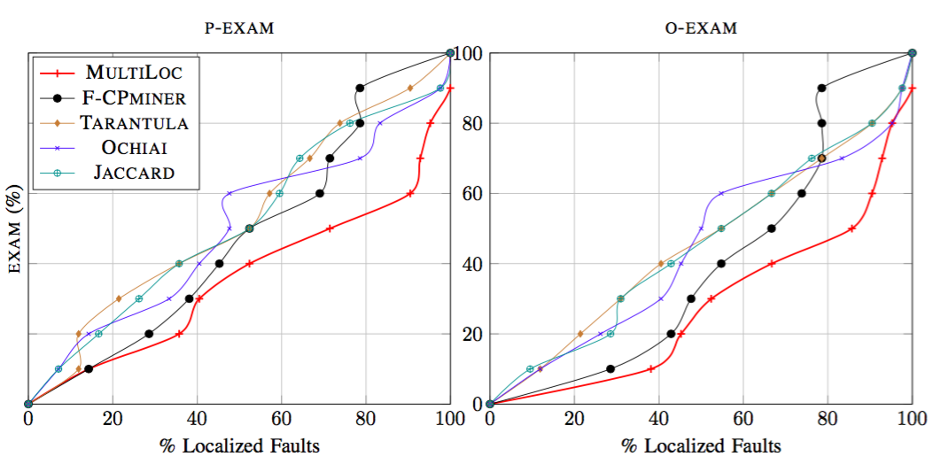
Experiments: Effectiveness comparison
MULTILOC is highly competitive
Notes:
We show here a a comparison between our approach and some measure and FCPminer which use also declarative data mining. The x-axis reports the cumulative percentages of located faults, while y-axis reports the E X A M score. We can see that with MultiLoc we are able to locate all faults using less examscore than others methods in both cases optimistic and pessimistic, which make MultiLoc highly competitive

Slide 17
Experiments: Statistical analysis
Statistical analysis using Wilcoxon Signed-rank Test
H₁: MULTILOC is better than approach X
H₁ is accepted with:
Notes:
An another result, we carried out a statistical studie, for that we used wilcoxon test, we have used the one-tailed alternative hypothesis, here we state that MULTILOC is better than a given approach X, and this hypotesis is accepted with the following propabilities, this result cofirms that MultiLoc is better than other approaches for localization

Slide 18
Conclusions & Perspectives
A new MFL approach using declarative itemset mining
Approach in 2 steps:
  top-k suspicious patterns : CP and PSD-dominance relation
  Ranking algorithm for a finer-grained localization
Use expressive patterns for fault localization problem
Explore more observations on faulty program
Use sequence mining

Slide 19
Thanks!
Questions ...

Slide 20
Conclusion
A new approach for multiple fault localization
Use of a global constraint CLOSEDPATTERN and PSD measure
MULTILOC propose a more precise localization

Slide 21
top-k suspicious itemsets : Analysis
- Each itemset : subset of statements that can locate faults
- 1st localization: itemsets can be quite large
- From a S_{i} to S_{i+1} : some statements appear/disappear
-∃2 categories of statements composing top-k
Notes:
After the first based that extract the topk suspicious pattern, w perform an analyse on these patterns. Here each pattern is a subset of statements that can contains the faults of the program. These are considered as a first localization, but here the patterns can be large, so we conduct a post-treatemnt to understand better the information provided by these patterns.
We have seen that From a pattern to the next one which is less suspicious some statements appear/disappear according to their frequencies in both dataset. We have established some rules and observations and we have extracted 3 categories of statements that compose the top-k suspicious itemsets

Slide 22
MULTILOC -> suspicious itemset S
Frequency:
The itemset S must appear at least once in T⁻ : freq⁻(S) ≥ 1
Closedness:
The largest itemset for a given degree of suspiciousness
CLOSEDPATTERN_{T,θ}(S), such that T = T⁺ U T⁻
Notes:
To extract top k suspicious model our model

Slide 23
top-k suspicious itemsets : example
- Each S_{i} : subset of statements that can locate de faulty statement
- 1st localization: but itemsets can be quite large -> refine the result

Slide 24
Fault Localization
Our approach -> step2 : statements ranking
From an itemset S_{i} to another S_{i+1} some statements appear/disappear
There exists 3 categories of statements composing top-k suspicious itemsets.

Slide 25
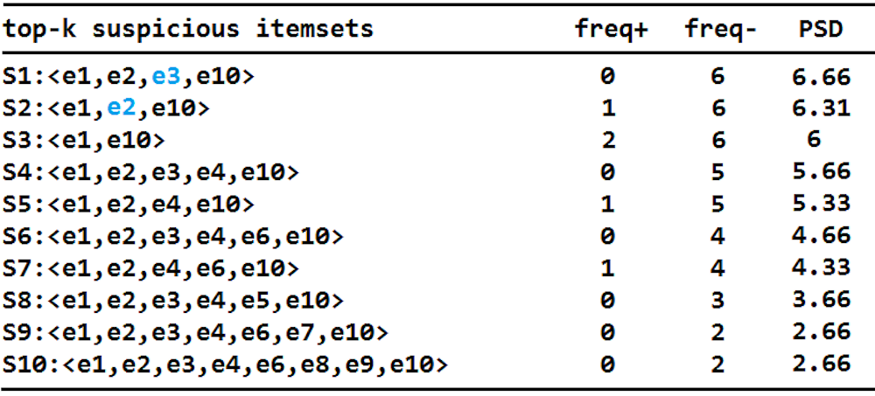
top-k suspicious itemsets : Ranking
Observations and rules:
Statements e_{i} ∈ S_{i} and disappear in S_{j} (j=i+1..k)
Suspect : most suspicious
Notes:
La question ne se pose pas avec les frequences négatives car elle ne peut que décroitre

Slide 26
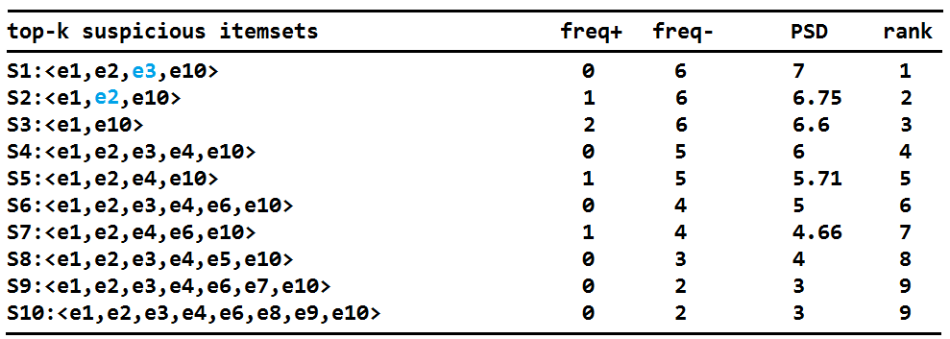
Fault Localization
Our approach -> step2 : statements ranking
Observations and rules:
Statements that belong to S₁ and not in S_{i} (i=2..k)
∆_{D} ← S₁\ S_{i}
foreach e ∈ ∆_{D}
  if (freq⁺[e] < freq⁺[S_{i}]) then
  Ω₁ ← e
Notes:
La question ne se pose pas avec les frequences négatives car elle ne peut que décroitre

Slide 27
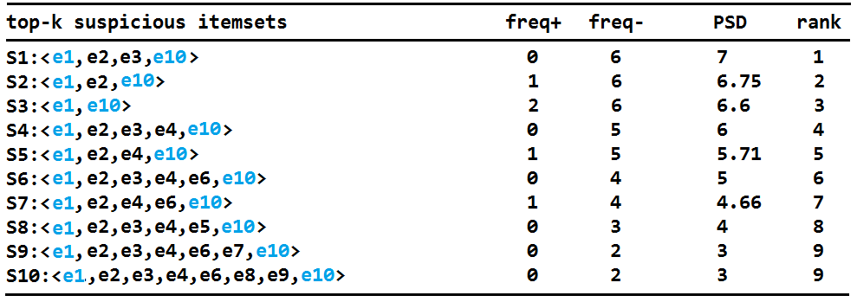
Fault Localization
Our approach -> step2 : statements ranking
Observations and rules:
Statements that belong to all S_{i} (i=1..k) → Ω₂

Slide 28
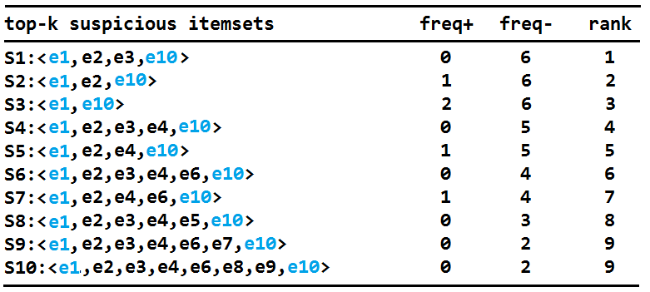
step2 : statements ranking
Observations and rules:
Statements that belong to all S_{i} (i=1..k)
Ω₂: neutral

Slide 29
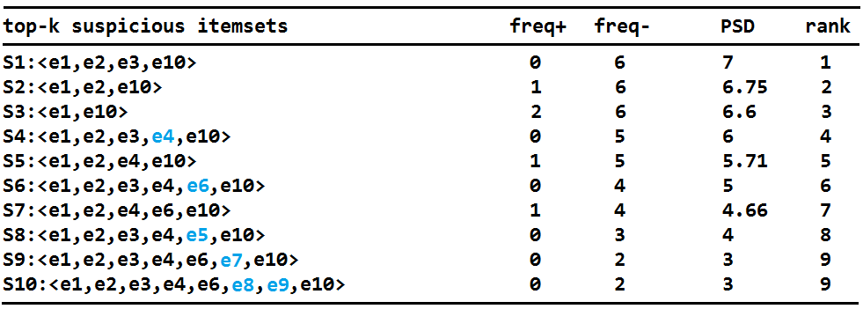
Fault Localization
Our approach -> step2 : statements ranking
Observations and rules:
Statements that do not belong to S₁ and appear gradually in S_{i} (i=2..k)
Note : we have shown experimentally in a previous work[1] that in almost all cases the fault is on S₁
[1] : Fault localization using itemset mining under constraint. ASE Journal 2016

Slide 30
Statements ranking
Ranking = < Suspect , Pending , Guilty >
Statements | Rank | List
e3 | 1 | Suspect
e2 | 2 | Suspect
e1,e10 | 4 | Pending
e4 | 5 | Ω₃
e6 | 6 | Ω₃
e5 | 7 | Ω₃
e7 | 8 | Ω₃
e8,e9 | 10 | Guilty

